Slide 1
DIGITAL SYSTEMS
PROJECT
SMART HOME: Voice Controlled Home Automation
BY:
Team ID 11
M Shanmukha Priya 2101CS40
Mamta Kanwar 2101CS42
Amisha Raje 2101CS08

Slide 2
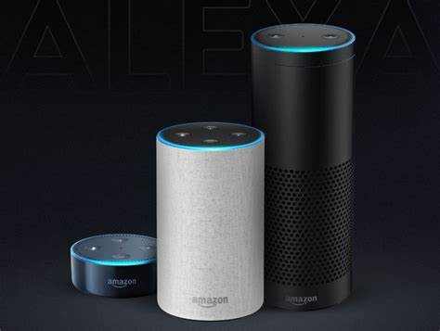
Objective
Components
Experimental Setup
Contents
Schematic and Circuit Diagram
Working Principle
Demonstration
How it Works?
Conclusion

Slide 3
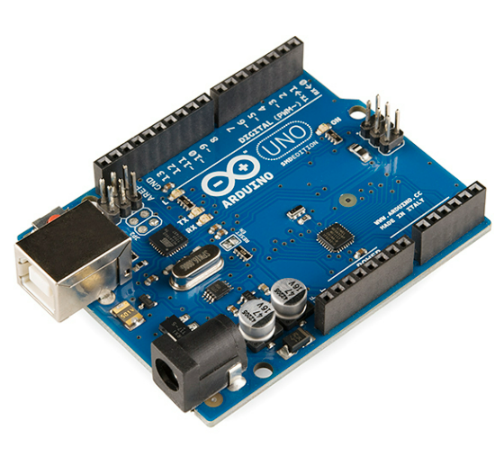
Objective:
Voice Controlled Home Automation project using Arduino.
It enables the user to control home appliances through our voice command through our android app, which in turn passes to the Arduino through Bluetooth.

Slide 4
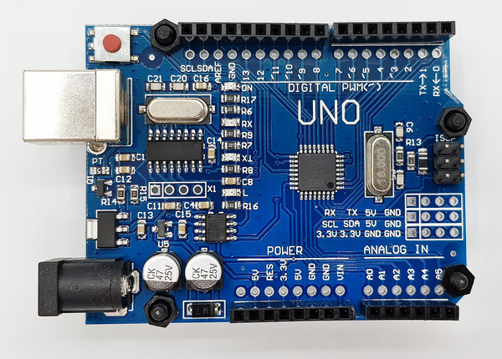
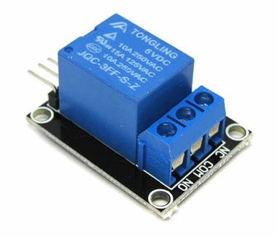

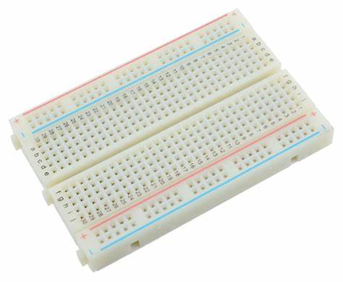
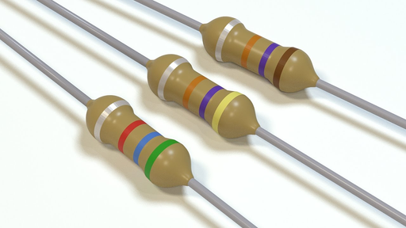
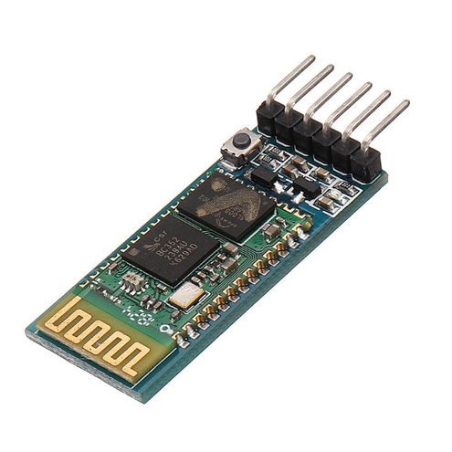
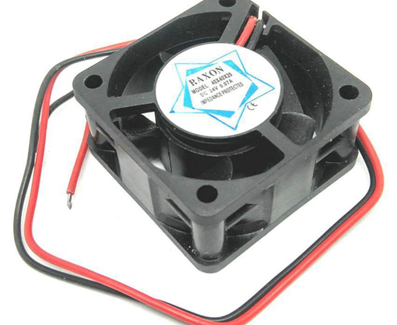
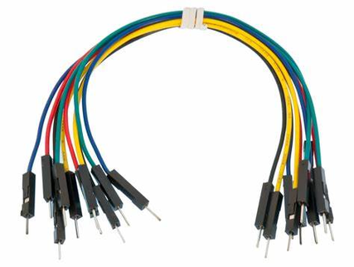
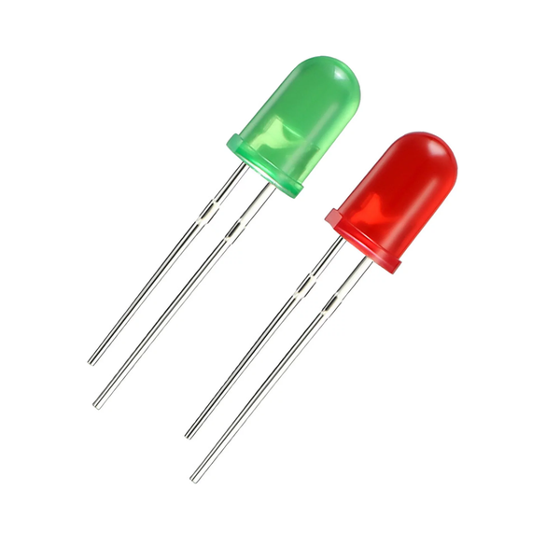
COMPONENTS
ARDUINO UNO
RELAY
BATTERY
BREADBOARD
RESISTOR
.
BLUETOOTH MODULE
DC FAN
JUMPER WIRES
LED
.

Slide 5
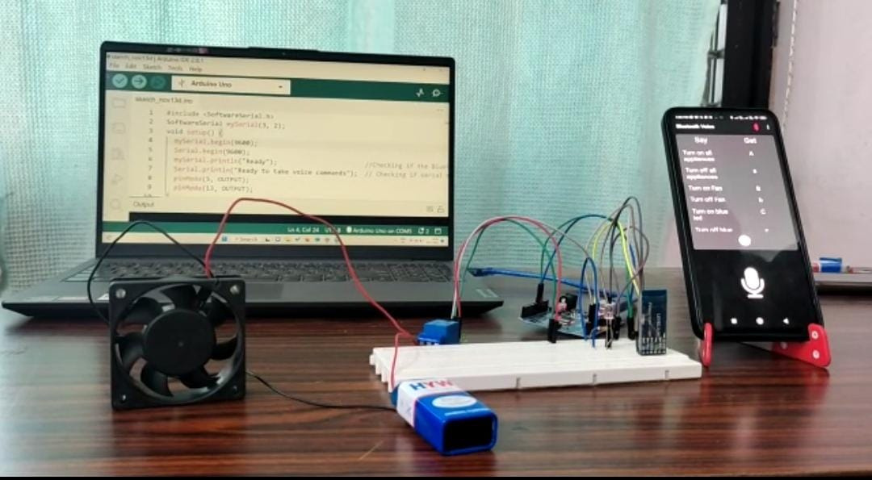
Experimental Setup

Slide 6
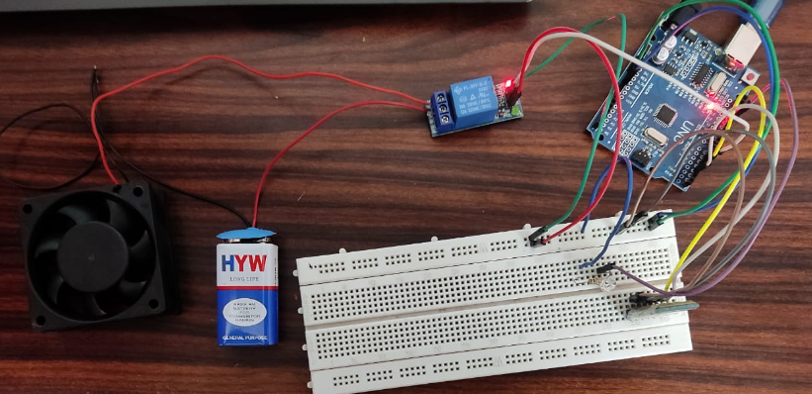
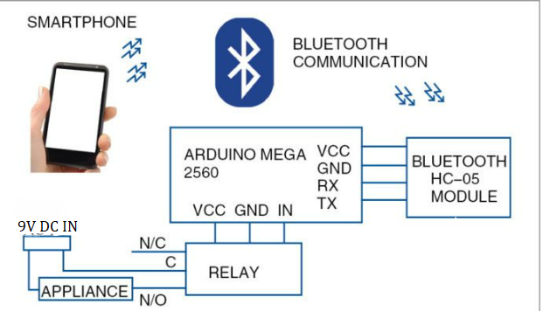
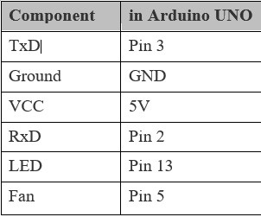
Schematic
Circuit Diagram

Slide 7
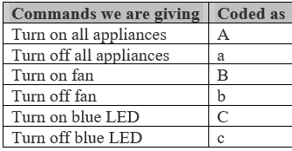
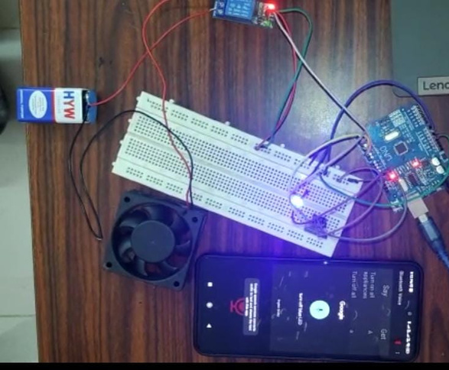
Working Principle
Voice commands to our Android app are converted into text which pass the command to our Arduino via Bluetooth thus controlling the appliances.
After reading the data, the microcontroller decodes the input value and sends a signal to the parallel port through which the relay circuit will be activated.
The relay is connected to the output pins of Arduino UNO, which is used as a switch to the load.

Slide 8
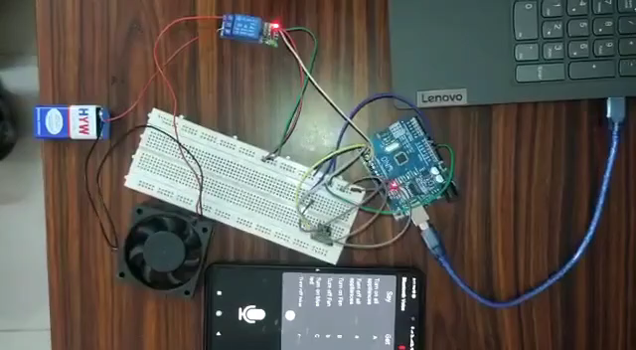
How it Works?
(the technical part)
The Android app reads the voice and converts the audio signal into text. If this text matches any of the commands, the app sends a single character, mapped to a particular command, to the Bluetooth module.
Based on the character received, we can control if each appliance goes HIGH or LOW.
Click below to play the video
Demonstration Video

Slide 9
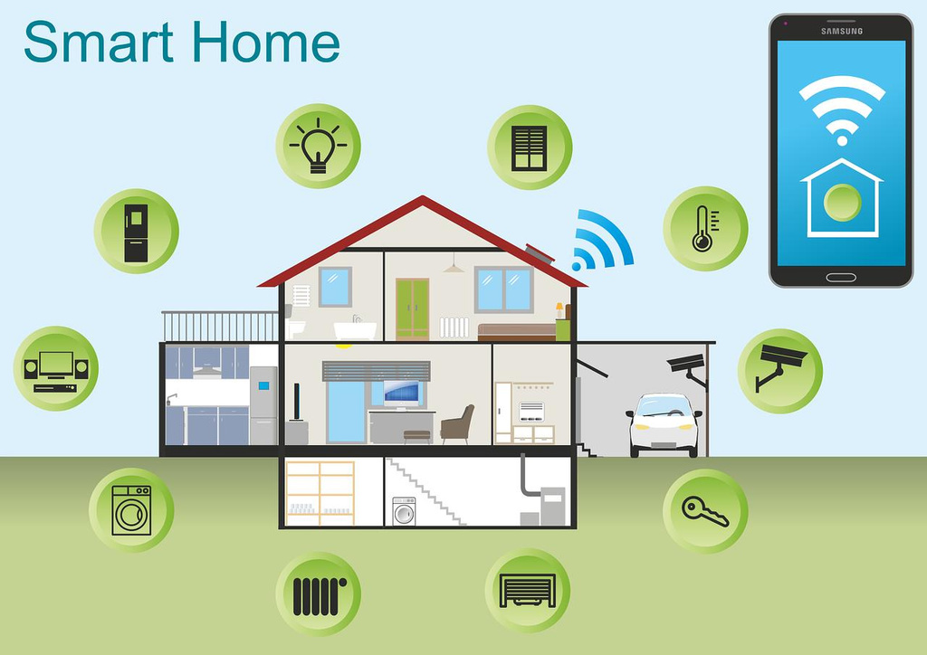
Conclusion
Our idea aims to control the AC Home Appliances which is done easily using 220 V AC from our houses instead of the 9V battery.
We can also control Air conditioners, door locks, televisions, thermostats, home monitors, cameras, lights, refrigerators etc. in a similar manner.
That would automate the entire home and ease the process of switching on and off appliances.
This app is also very beneficial for disabled people.

Slide 10
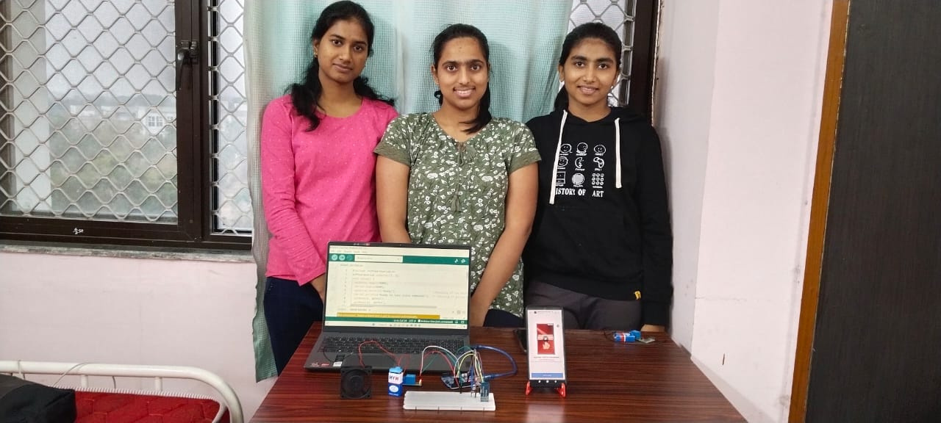
Thank You!!

